Slide 1
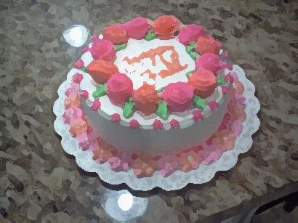
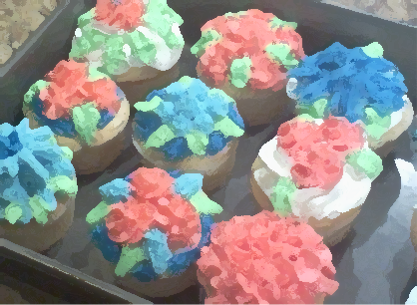

Life is better with Cake…
And Cupcakes too. ☺

Slide 2

Reasons to Make a Cake:
1.
Birthdays/Holidays
2.
To give to friends and neighbors
3.
Just for Fun

Slide 3
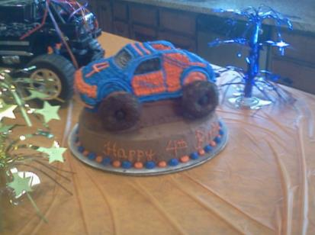
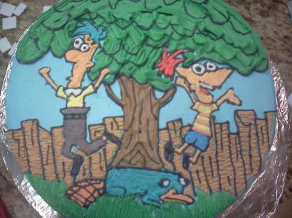
Ideas for Birthday Cakes:
Be inspired from your child’s
Favorite tv show.
Or your child’s
favorite toy.

Slide 4
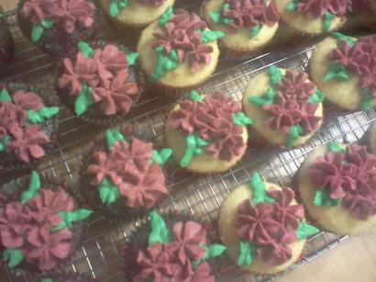
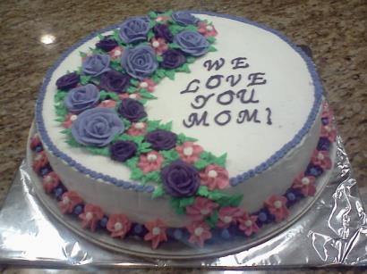
Ideas for Holiday Sweets:
Christmas Time
Mother’s Day

Slide 5
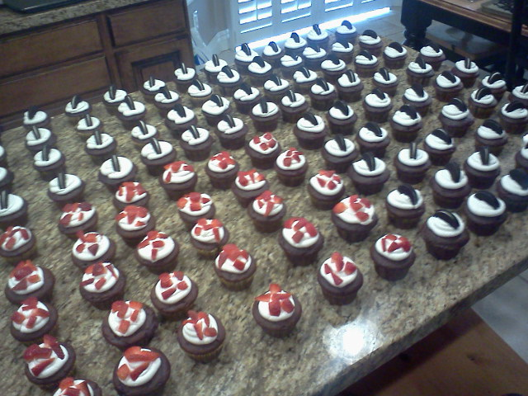
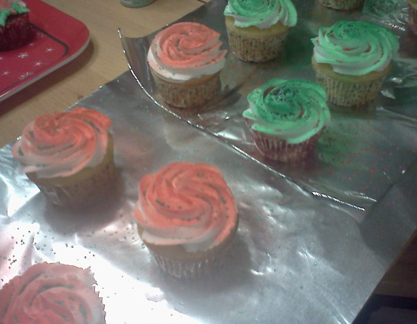
Ideas for Creating just for Fun:
When a friend is in need,
bake a yummy treat!!
Or if you are bored, bake a yummy treat
Just for fun~

Slide 6
Birthdays | Holidays | Just for fun
Children’s | Christmas | For someone in need
Spouse | Easter | For someone who had a baby
Friend | Mother’s Day | For a community event
Family | Halloween and More! | To brighten your day

Slide 7
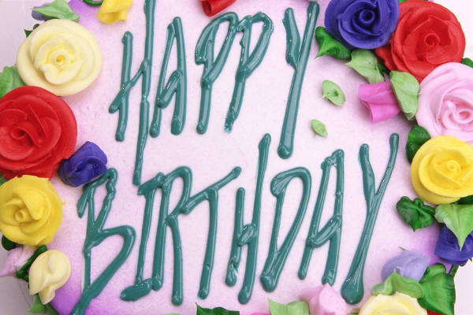
Plan
Organize
Prepare
Bake
Decorate
Enjoy

Slide 8
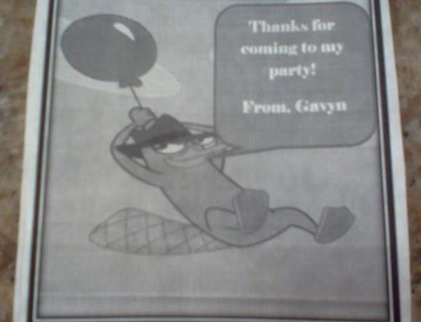
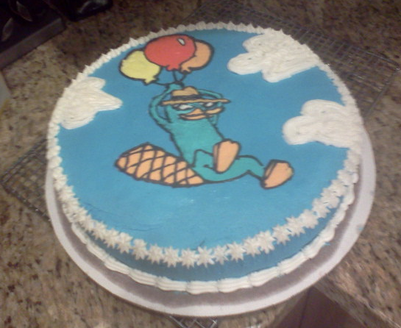
Great Tip for how
to decorate the cake:
Find a picture and use
it to freehand the frosting.

Slide 9

Life is definitely better with cake!
Show someone you care and
bake them a special sweet today!

